Slide 1
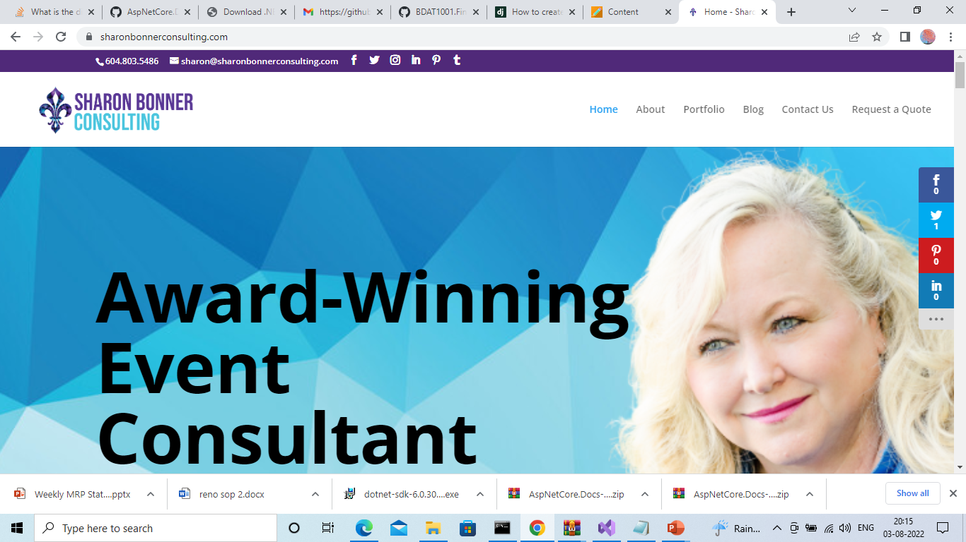
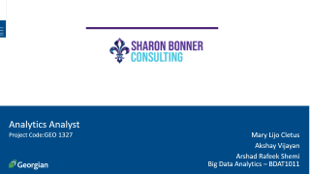
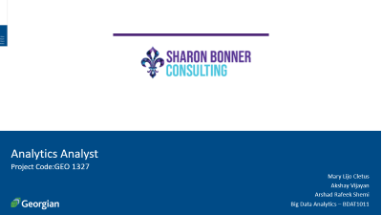
Analytics Analyst
Project Code:GEO 1327
Mary Lijo Cletus
Akshay Vijayan
Arshad Rafeek Shemi
Big Data Analytics – BDAT1011

Slide 2
Team Profile
Akshay Vijayan
Arshad Rafeek Shemi
Mary Lijo Cletus
Developer
Business Analyst
Data Analyst
Data analysis and data visualization
Managing proper communication between client and the team,
Data analysis
Managing cleaning and developing solutions from data
Development and testing

Slide 3
Data Scrapping
As part of Analytics analyst project we have scraped data from the company websites provided by our client
We used python for scraping the data

Slide 4
Data Sources
https://rsgevents.ca/services/
https://vestievents.com/
https://eventqueen.ca/services

Slide 5
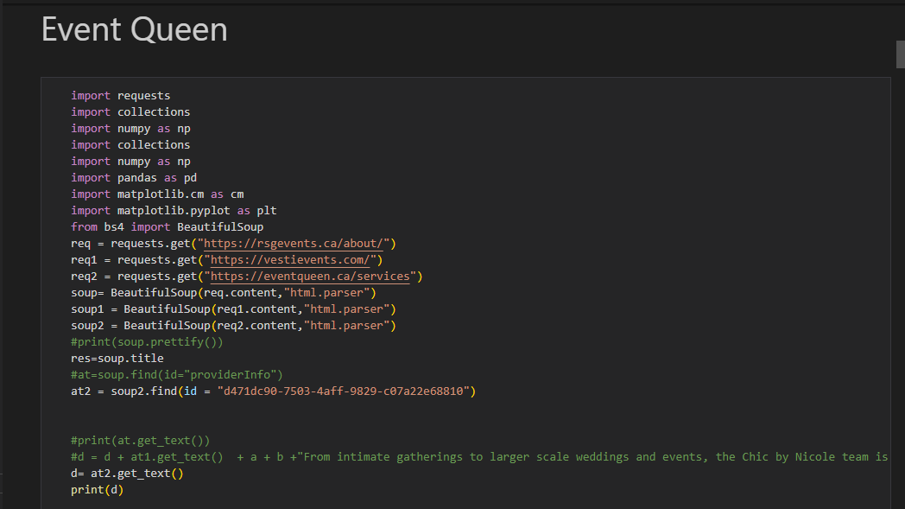
Python Web Scrapping Code

Slide 6
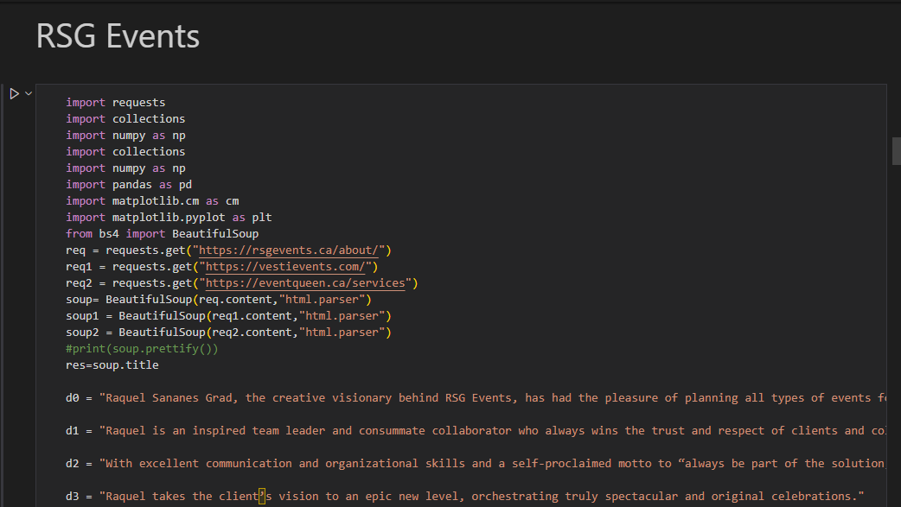

Slide 7
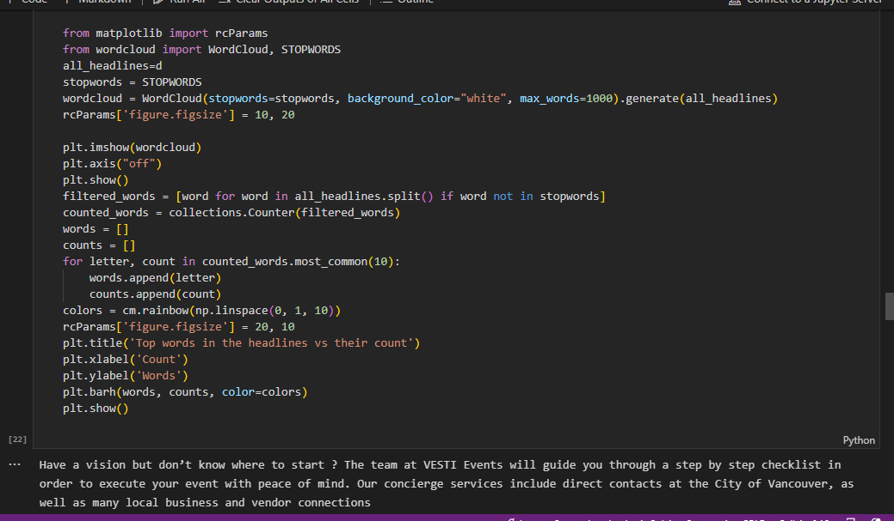

Slide 8
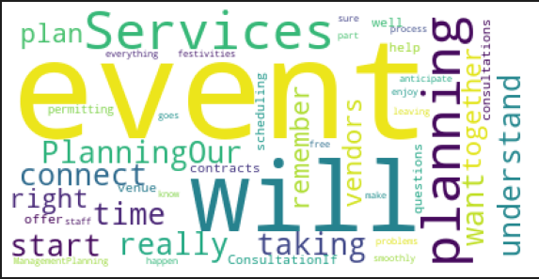
Event Queen

Slide 9
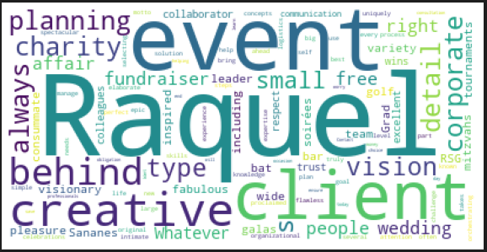
RSG Events

Slide 10
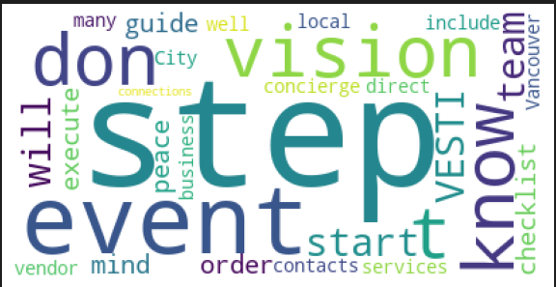
Vesti Events

Slide 11
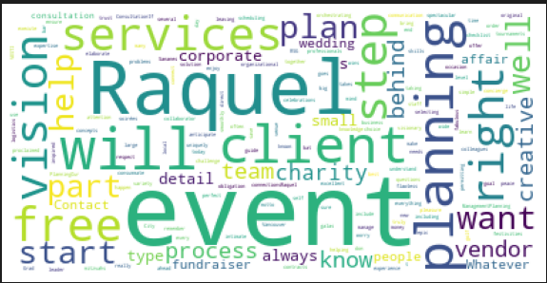
All Together

Slide 12
Suggestions
We can use the highlighted keywords for SEO Keyword Optimization
Event
Raquel
Planning
Vision
Services
Client
Right
Help

Slide 13
Thank you

